Slide 1
{{TYPE}}
PARTICIPANTS
{{DATE}}
NOM J1 | CLASSEMENT J1 | NOM J2 | CLASSEMENT J2 | POIDS | TS
Nom 1 | Classement 1 | Nom 2 | Classement 2 | Poids | TS
{{CLUB}}

Slide 2





P100 Mixte
12 Équipes
30 Juin 2026
18:30
4 terrains
padel tournament engine

Slide 3
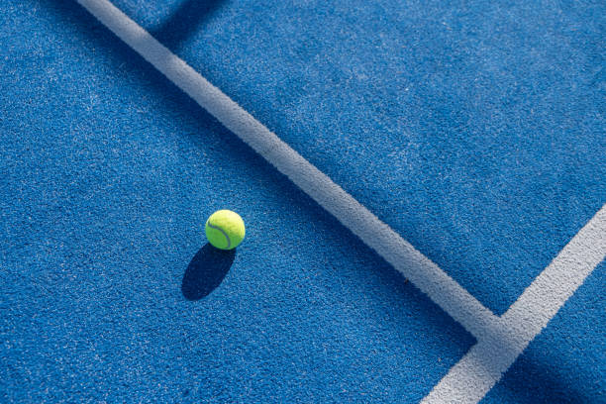
{{LOGO}}
{{TYPE}}
{{DATE}}
{{HEURE}}
{{NB_EQUIPES}}
{{NB_TERRAINS}}
padel tournament engine

Slide 4
P250 Mixte
30 Juin 2026
18:30
12 Équipes
4 terrains
padel tournament engine

Slide 5
P100 FEMMES
30 Juin 2026
18:30
12 Équipes
4 terrains
padel tournament engine

Slide 6
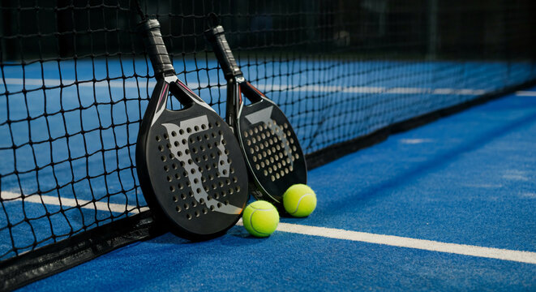
P100 Mixte
12 Équipes
30 Juin 2026
18:30
4 terrains
padel tournament engine

Slide 7
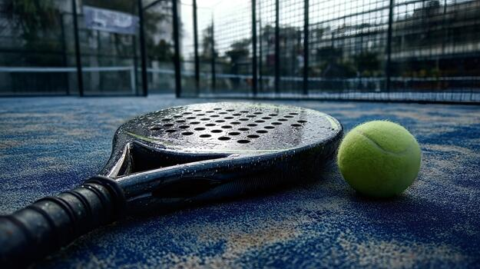
P100 Mixte
12 Équipes
30 Juin 2026
18:30
4 terrains
padel tournament engine

Slide 8
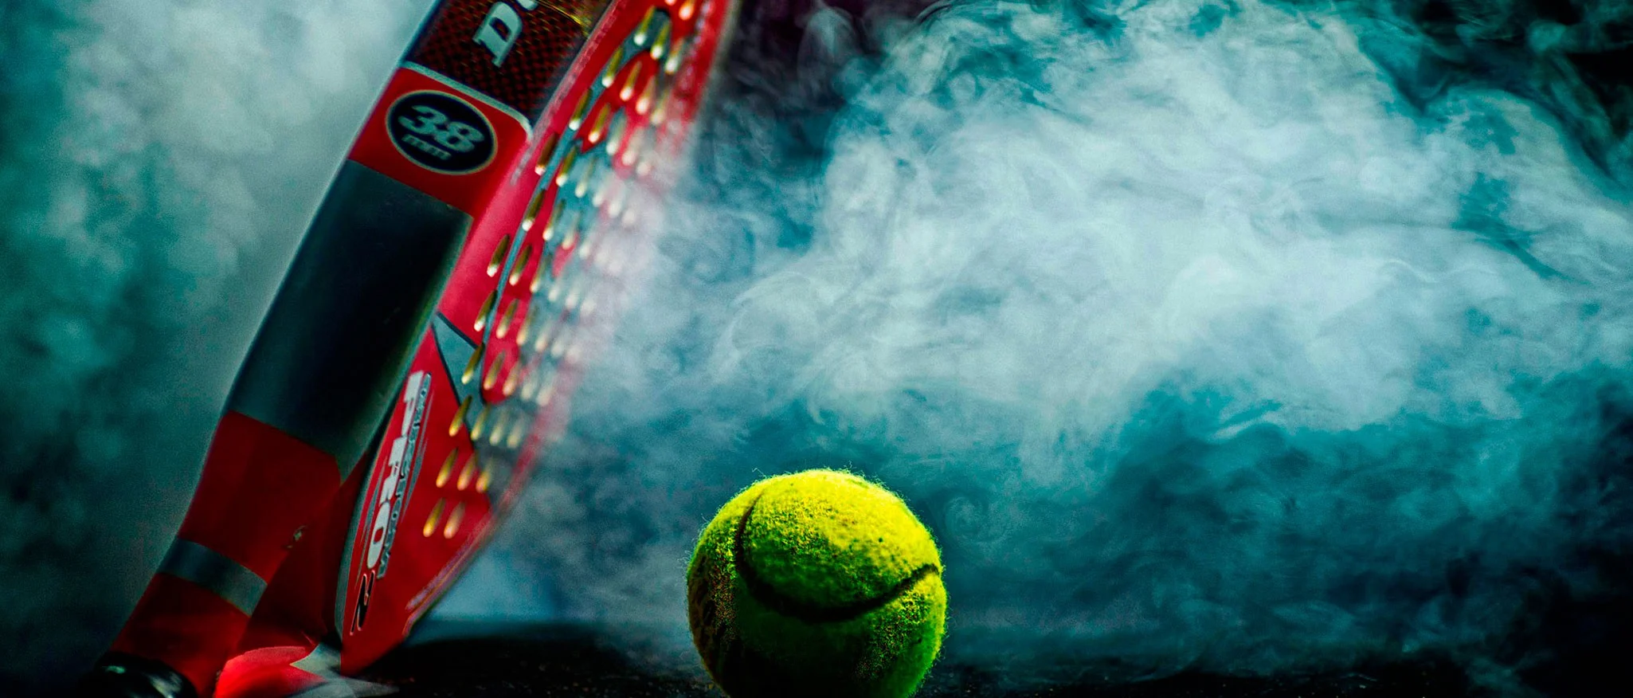
P100 Mixte
12 Équipes
30 Juin 2026
18:30
4 terrains
padel tournament engine

Slide 9
P100 Mixte
12 Équipes
30 Juin 2026
18:30
4 terrains
padel tournament engine

Slide 10
PARTICIPANTS
{{TYPE}}
{{DATE}}
NOM J1 | CLASSEMENT J1 | NOM J2 | CLASSEMENT J2 | POIDS | TS
Nom 1 | Classement 1 | Nom 2 | Classement 2 | Poids | TS
{{CLUB}}

Slide 11
{{TYPE}}
CONVOCATIONS
{{DATE}}
ÉQUIPE | HEURE
{{CONV_NOMS}} | {{CONV_HORAIRE}}
{{CLUB}}

Slide 12
{{TYPE}}
TOUR PRÉLIMINAIRE
{{DATE}}
{{P1_CODE}}
{{P1_TERRAIN}}
{{P1_HEURE}}
{{P1_EQ1}}
vs
{{P1_EQ2}}
score:
{{P2_CODE}}
{{P2_TERRAIN}}
{{P2_HEURE}}
{{P2_EQ1}}
vs
{{P2_EQ2}}
score:
{{P2_TERRAIN}}
{{P4_CODE}}
{{P4_HEURE}}
{{P3_EQ1}}
vs
{{P3_EQ2}}
score:
{{P4_TERRAIN}}
{{P4_CODE}}
{{P4_HEURE}}
{{P4_EQ1}}
vs
{{P4_EQ2}}
score:

Slide 13
{{TYPE}}
TABLEAU PRINCIPAL
{{DATE}}
{{Q1_CODE}}
{{Q1_TERRAIN}}
{{Q1_HEURE}}
{{Q1_EQ1}}
vs
{{D1_TERRAIN}}
{{WIN_P1}}
{{D1_CODE}}
{{D1_HEURE}}
score:
{{WIN_Q1}}
vs
{{Q2_TERRAIN}}
{{WIN_Q2}}
{{Q2_CODE}}
{{Q2_HEURE}}
{{Q2_EQ1}}
score:
vs
{{WIN_P2}}
{{F_TERRAIN}}
{{F_CODE}}
{{F_HEURE}}
score:
{{WIN_D1}}
vs
{{Q3_CODE}}
{{WIN_D2}}
{{Q3_TERRAIN}}
{{Q3_HEURE}}
{{WIN_P3}}
score:
vs
{{D2_TERRAIN}}
{{Q3_EQ2}}
{{D2_CODE}}
{{D2_HEURE}}
score:
{{WIN_Q3}}
vs
{{PF_TERRAIN}}
{{Q4_TERRAIN}}
{{WIN_Q4}}
{{PF_CODE}}
{{PF_HEURE}}
{{Q4_CODE}}
{{Q4_HEURE}}
{{WIN_P4}}
score:
{{LOSE_D1}}
vs
vs
{{Q4_EQ2}}
{{LOSE_D2}}
score:
score:
{{CLUB}}

Slide 14
{{TYPE}}
CLASSEMENT 5-8
{{DATE}}
{{C5_8_1_TERRAIN}}
{{C5_8_1_CODE}}
{{C5_8_1_HEURE}}
{{LOSE_Q1}}
vs
{{LOSE_Q2}}
score:
7-8
5-6
{{C5_6_TERRAIN}}
{{C7_8_TERRAIN}}
{{C5_6_CODE}}
{{C5_6_HEURE}}
{{C7_8_CODE}}
{{C7_8_HEURE}}
{{LOSE_C5_8_1}}
{{WIN_C5_8_1}}
vs
vs
{{LOSE_C5_8_2}}
{{WIN_C5_8_2}}
score:
score:
{{C5_8_2_CODE}}
{{C5_8_2_TERRAIN}}
{{C5_8_2_HEURE}}
{{LOSE_Q3}}
vs
{{LOSE_Q4}}
score:
{{CLUB}}

Slide 15
{{TYPE}}
CLASSEMENT 9-12
{{DATE}}
{{C9_12_1_TERRAIN}}
{{C9_12_1_CODE}}
{{C9_12_1_HEURE}}
{{LOSE_P1}}
vs
{{LOSE_P2}}
score:
11-12
9-10
{{C9_10_TERRAIN}}
{{C11_12_TERRAIN}}
{{C9_10_CODE}}
{{C9_10_HEURE}}
{{C11_12_CODE}}
{{C11_12_HEURE}}
{{LOSE_C9_12_1}}
{{WIN_C9_12_1}}
vs
vs
{{LOSE_C9_12_2}}
{{WIN_C9_12_2}}
score:
score:
{{C9_12_2_CODE}}
{{C9_12_2_TERRAIN}}
{{C9_12_2_HEURE}}
{{LOSE_P3}}
vs
{{LOSE_P4}}
score:
{{CLUB}}

Slide 16
{{TYPE}}
PLANNING DES MATCHS
{{DATE}}
MATCH | HEURE | TERRAIN | EQUIPE 1 | ÉQUIPE 2 | TERMINÉ
{{PL1_CODE}} | {{PL1_HEURE}} | {{PL1_TERRAIN}} | {{PL1_EQ1}} | {{PL1_EQ2}} | ☐
{{PL2_CODE}} | {{PL2_HEURE}} | {{PL2_TERRAIN}} | {{PL2_EQ1}} | {{PL2_EQ2}} | ☐
{{PL3_CODE}} | {{PL3_HEURE}} | {{PL3_TERRAIN}} | {{PL3_EQ1}} | {{PL3_EQ2}} | ☐
{{PL4_CODE}} | {{PL4_HEURE}} | {{PL4_TERRAIN}} | {{PL4_EQ1}} | {{PL4_EQ2}} | ☐
{{PL5_CODE}} | {{PL5_HEURE}} | {{PL5_TERRAIN}} | {{PL5_EQ1}} | {{PL5_EQ2}} | ☐
{{PL6_CODE}} | {{PL6_HEURE}} | {{PL6_TERRAIN}} | {{PL6_EQ1}} | {{PL6_EQ2}} | ☐
{{PL7_CODE}} | {{PL7_HEURE}} | {{PL7_TERRAIN}} | {{PL7_EQ1}} | {{PL7_EQ2}} | ☐
{{PL8_CODE}} | {{PL8_HEURE}} | {{PL8_TERRAIN}} | {{PL8_EQ1}} | {{PL8_EQ2}} | ☐
{{PL9_CODE}} | {{PL9_HEURE}} | {{PL9_TERRAIN}} | {{PL9_EQ1}} | {{PL9_EQ2}} | ☐
{{PL10_CODE}} | {{PL10_HEURE}} | {{PL10_TERRAIN}} | {{PL10_EQ1}} | {{PL10_EQ2}} | ☐
{{PL11_CODE}} | {{PL11_HEURE}} | {{PL11_TERRAIN}} | {{PL11_EQ1}} | {{PL11_EQ2}} | ☐
{{PL12_CODE}} | {{PL12_HEURE}} | {{PL12_TERRAIN}} | {{PL12_EQ1}} | {{PL12_EQ2}} | ☐
{{PL13_CODE}} | {{PL13_HEURE}} | {{PL13_TERRAIN}} | {{PL13_EQ1}} | {{PL13_EQ2}} | ☐
{{PL14_CODE}} | {{PL14_HEURE}} | {{PL14_TERRAIN}} | {{PL14_EQ1}} | {{PL14_EQ2}} | ☐
{{PL15_CODE}} | {{PL15_HEURE}} | {{PL15_TERRAIN}} | {{PL15_EQ1}} | {{PL15_EQ2}} | ☐
{{PL16_CODE}} | {{PL16_HEURE}} | {{PL16_TERRAIN}} | {{PL16_EQ1}} | {{PL16_EQ2}} | ☐
{{PL17_CODE}} | {{PL17_HEURE}} | {{PL17_TERRAIN}} | {{PL17_EQ1}} | {{PL17_EQ2}} | ☐
{{PL18_CODE}} | {{PL18_HEURE}} | {{PL18_TERRAIN}} | {{PL18_EQ1}} | {{PL18_EQ2}} | ☐
{{PL19_CODE}} | {{PL19_HEURE}} | {{PL19_TERRAIN}} | {{PL19_EQ1}} | {{PL19_EQ2}} | ☐
{{PL20_CODE}} | {{PL20_HEURE}} | {{PL20_TERRAIN}} | {{PL20_EQ1}} | {{PL20_EQ2}} | ☐
{{CLUB}}

Slide 17
{{TYPE}}
CLASSEMENT FINAL / POINTS
{{DATE}}
PLACE | EQUIPE | POINTS
🥇 1 🥇 |  | {{PTS1}}
🥈 2 🥈 |  | {{PTS2}}
🥉 3 🥉 |  | {{PTS3}}
4 |  | {{PTS4}}
5 |  | {{PTS5}}
6 |  | {{PTS6}}
7 |  | {{PTS7}}
8 |  | {{PTS8}}
9 |  | {{PTS9}}
10 |  | {{PTS10}}
11 |  | {{PTS11}}
12 |  | {{PTS12}}
{{CLUB}}

Slide 19
{{TYPE}}
POULE A
{{DATE}}
{{PA_M1_TERRAIN}}
{{PA_M1_CODE}}
{{PA_M1_HEURE}}
{{PA_M3_TERRAIN}}
{{PA_M3_CODE}}
{{PA_M3_HEURE}}
{{PA_M5_TERRAIN}}
{{PA_M5_CODE}}
{{PA_M5_HEURE}}
{{POULE_A_1_EQ}}
{{POULE_A_1_EQ}}
{{POULE_A_1_EQ}}
vs
vs
vs
{{POULE_A_4_EQ}}
{{POULE_A_3_EQ}}
{{POULE_A_2_EQ}}
score:
score:
score:
{{PA_M6_TERRAIN}}
{{PA_M2_TERRAIN}}
{{PA_M6_CODE}}
{{PA_M6_HEURE}}
{{PA_M2_CODE}}
{{PA_M2_HEURE}}
{{PA_M4_TERRAIN}}
{{PA_M4_CODE}}
{{PA_M4_HEURE}}
{{POULE_A_2_EQ}}
{{POULE_A_4_EQ}}
{{POULE_A_3_EQ}}
vs
vs
vs
{{POULE_A_3_EQ}}
{{POULE_A_2_EQ}}
{{POULE_A_4_EQ}}
score:
score:
score:
ÉQUIPE | VICTOIRES | DÉFAITES | JEUX | CLASSEMENT
{{POULE_A_1_EQ}}
{{POULE_A_2_EQ}}
{{POULE_A_3_EQ}}
{{POULE_A_4_EQ}}
{{CLUB}}

Slide 20
TABLEAU PRINCIPAL
{{TYPE}}
{{DATE}}
{{H1_TERRAIN}}
{{H1_CODE}}
{{H1_HEURE}}
{{H1_EQ1}}
vs
{{Q1_TERRAIN}}
{{H1_EQ2}}
{{Q1_CODE}}
{{Q1_HEURE}}
score:
{{WIN_H1}}
vs
{{H2_TERRAIN}}
{{WIN_H2}}
{{H2_CODE}}
{{H2_HEURE}}
{{H2_EQ1}}
score:
1-2
vs
{{H2_EQ2}}
{{D1_TERRAIN}}
{{D1_CODE}}
{{D1_HEURE}}
score:
{{WIN_Q1}}
vs
{{H3_CODE}}
{{WIN_Q2}}
{{H3_TERRAIN}}
{{H3_HEURE}}
{{H3_EQ1}}
score:
vs
{{Q2_TERRAIN}}
{{H3_EQ2}}
{{Q2_CODE}}
{{Q2_HEURE}}
score:
{{WIN_H3}}
vs
{{F_CODE}}
{{F_TERRAIN}}
{{H4_TERRAIN}}
{{WIN_H4}}
{{F_HEURE}}
{{H4_CODE}}
{{H4_HEURE}}
{{H4_EQ1}}
score:
{{WIN_D1}}
vs
vs
{{H4_EQ2}}
{{WIN_D2}}
score:
score:

Slide 21
CLASSEMENT 5-8
{{TYPE}}
{{DATE}}
{{C5_8_1_TERRAIN}}
{{C5_8_1_CODE}}
{{C5_8_1_HEURE}}
{{LOSE_Q1}}
vs
{{LOSE_Q2}}
7-8
score:
5-6
{{C7_8_CODE}}
{{C5_6_CODE}}
{{C5_6_TERRAIN}}
{{C5_6_HEURE}}
{{C7_8_TERRAIN}}
{{C7_8_HEURE}}
{{LOSE_C5_8_1}}
{{WIN_C5_8_1}}
vs
vs
{{LOSE_C5_8_2}}
{{WIN_C5_8_2}}
score:
score:
{{C5_8_2_TERRAIN}}
{{C5_8_2_CODE}}
{{C5_8_2_HEURE}}
{{LOSE_Q3}}
vs
{{LOSE_Q4}}
score:
{{LOGO}}

